Slide 1
TRAFFIC SIGN RECOGNITION USING KNN, SVM & CNN
ML & DL PROJECT

Slide 2
TEAM MEMBERS
ML
AVINASH KANUKUNTLA (LCI2020045)
RAMA KIRAN NITTALA (LCI2020006)
SHAMITA BADIREDDY (LCI2020060)
DL
AVINASH KANUKUNTLA (LCI2020045)
RAMA KIRAN NITTALA (LCI2020006)
VIVEK VARDHAN KOVA (LCI2020078)
SRIKANTH BANOTH (LCI2020079)

Slide 3
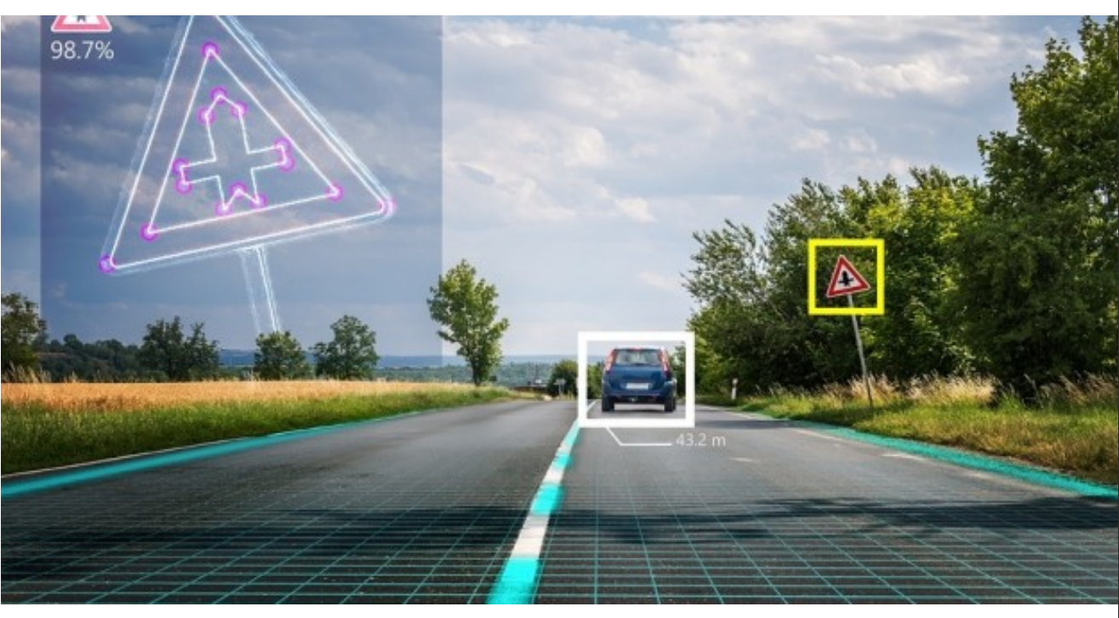
MOTIVATION
SELF DRIVING CARS
TRAFFIC SIGNS RECOGNITION

Slide 4
INtroduction
What is Traffic Sign Recognition?
There are several different types of traffic signs like speed limits, no entry, traffic signals, turn left or right, children crossing, no passing of heavy vehicles, etc.
Traffic signs classification is the process of identifying which class a traffic sign belongs to.

Slide 5
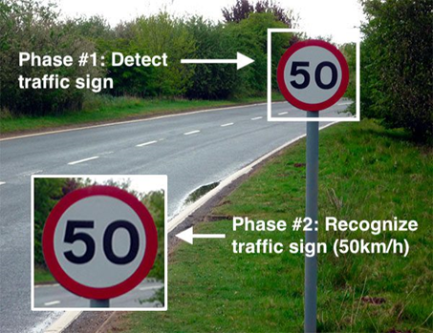
OBJECTIVE
In this Python project , we will build a classification model using KNN, SVM & CNN that can classify traffic signs present in the image into different categories.
With this model, we are able to read and understand traffic signs which are a very important task for all autonomous vehicles.

Slide 6
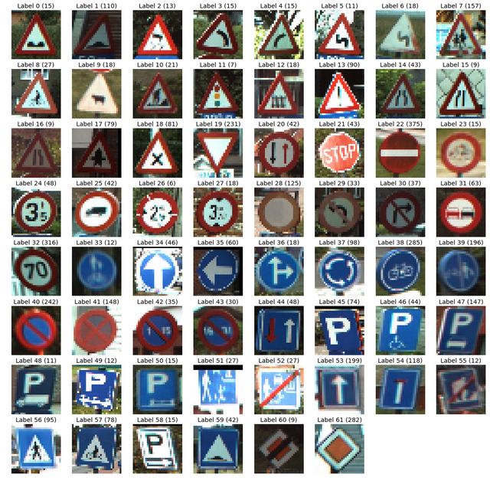
Dataset GTSRB (GERMAN TRAFFIC SIGN RECOGNITION BENCHMARK)
For this project, we are using the public dataset available at Kaggle link
The dataset contains more than 50,000 images of different traffic signs.
It is further classified into 43 different classes.
The size of the dataset is around 400 MB.
The dataset has a train folder which contains images inside each class and a test folder which we will use for testing our model.

Slide 7
Methodology
Feature Extraction
Learning Algorithm
Image Preprocessing

Slide 8
Feature extraction using HOG (Histogram of Oriented Gradients)
Hog is a feature descriptor used in computer vision and image processing applications for the purpose of the object detection.
It is a technique that counts events of gradient orientation in a specific portion of an image or region of interest.
HOG focuses on the structure of the object. It extracts the information of the edges magnitude as well as the orientation of the edges.

Slide 9
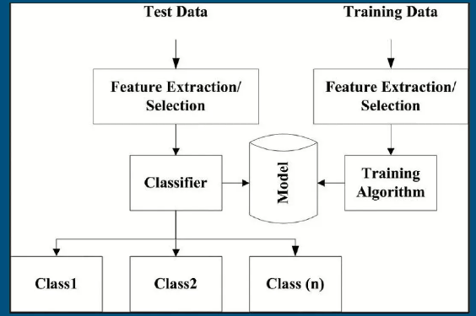
ML Classification Algorithms
SVM (Support Vector Machine)
KNN (K-Nearest Neighbors)

Slide 10
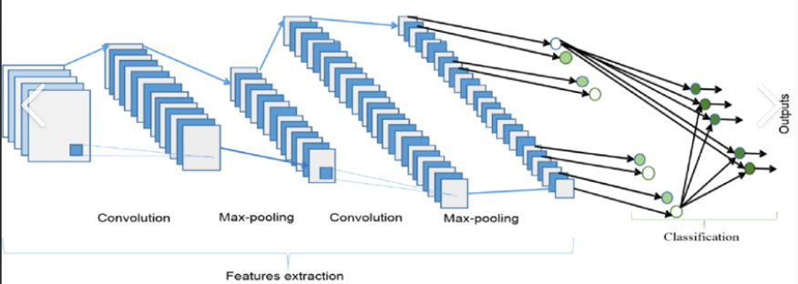
DEEP Learning
CNN (Convolutional Neural Network)

Slide 11
RESULTS
Using SVM model we achieved 93% accuracy.
Using KNN model we achieved 77% accuracy.
Using Deep Learning CNN model we achieved 94% accuracy.

Slide 12
References
GTSRB Traffic Sign recognition using machine learning (slideshare.net)
Real Time Myanmar Traffic Sign Recognition System using HOG and SVM (slideshare.net)
How ReLU and Dropout Layers Work in CNNs | Baeldung on Computer Science

Slide 13


